Slide 1


Computational Modeling of Human Movement: Exploring the Biomechanics, Neural Control, and Cognitive Processes Underlying Movements
Arefeh Farahmandi
April 2023

Slide 2
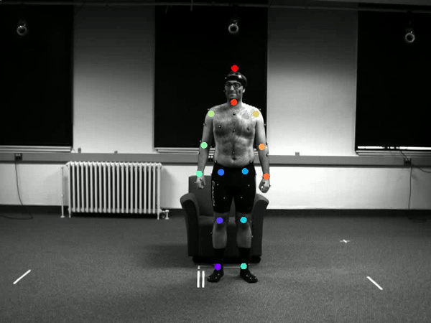
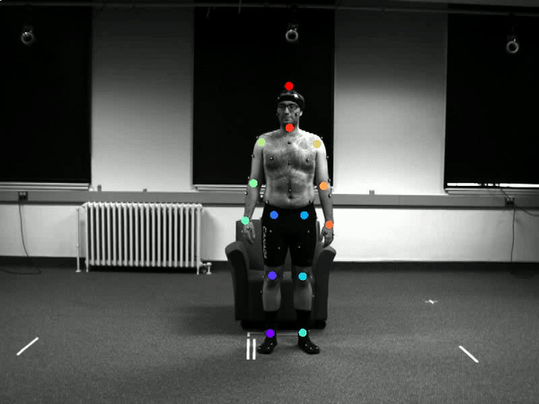
Project 1: Movement classification
Question: Does the model comprehend the movements in a way as humans do?
Can we make inference about NN in the process of training and after that?
-Deeplabcut( 14 joints, 21 movements)

Slide 3
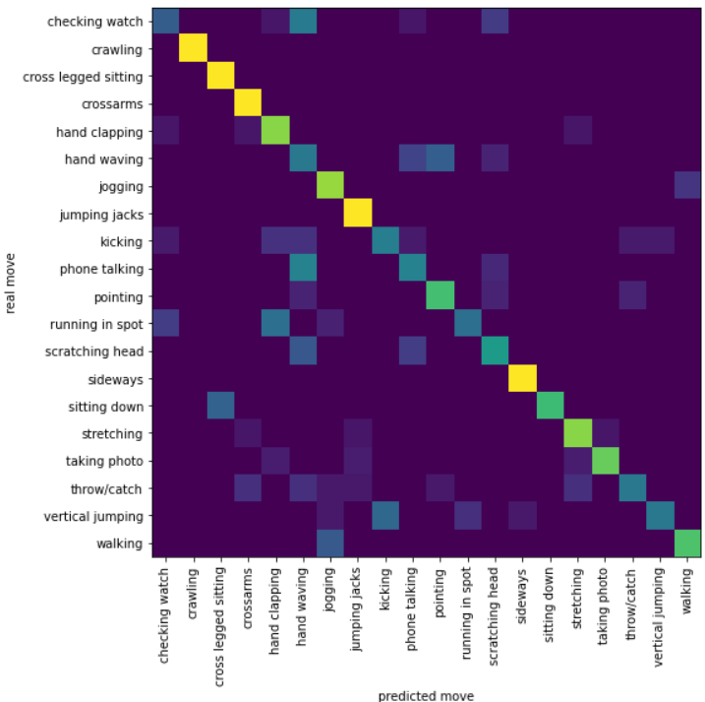
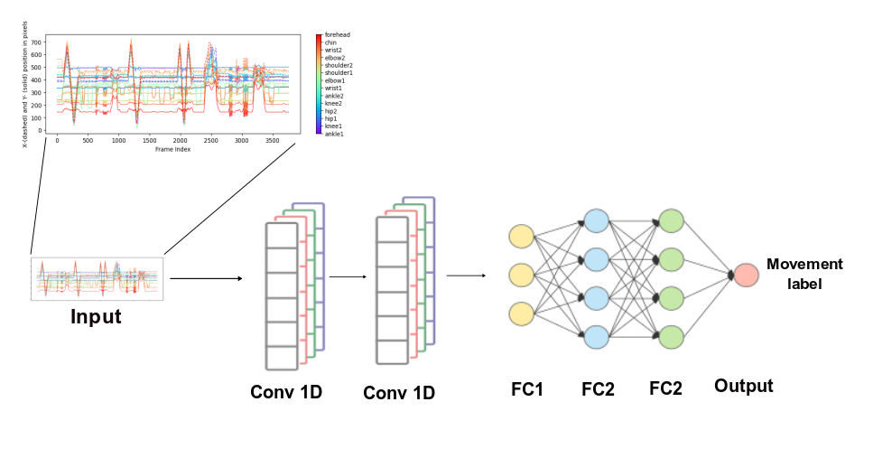
Model
Architecture
Performance

Slide 4
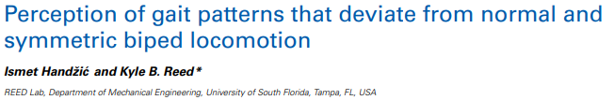
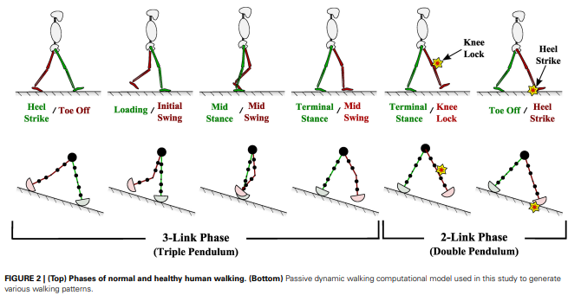
Motivation
Perception of gait
Walking patterns that shows degree of abnormality

Slide 5
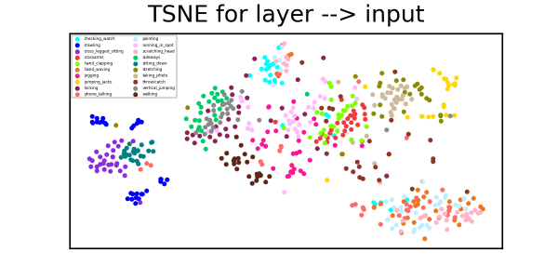
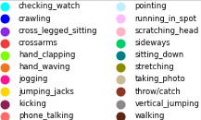
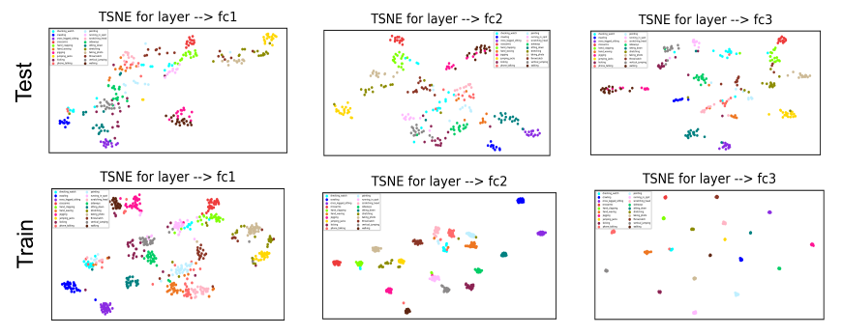
TSNE
Dimension Reduction

Slide 6
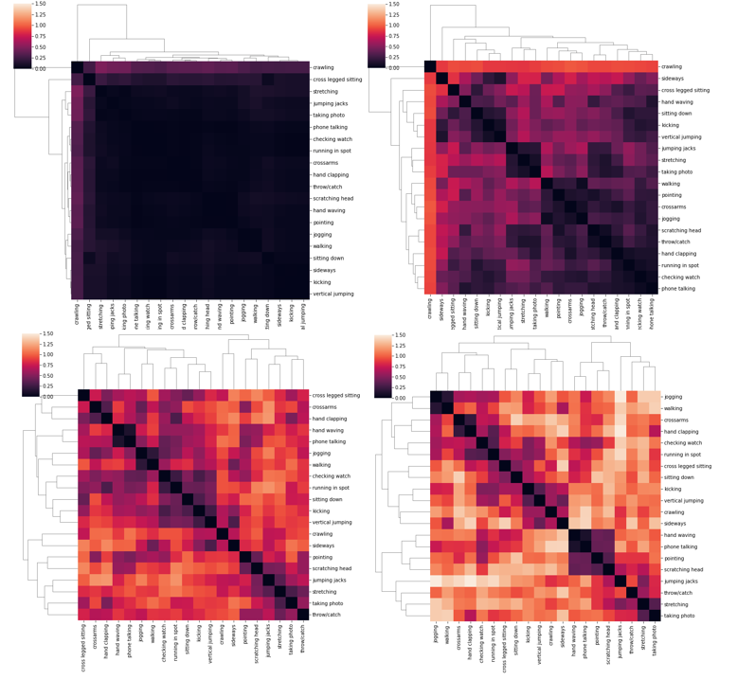
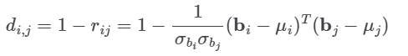
RDM
Dissimilarity Analysis

Slide 7
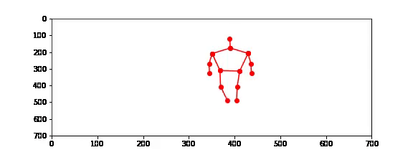
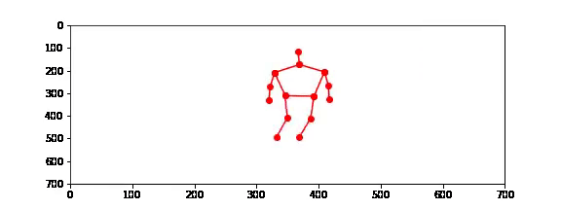
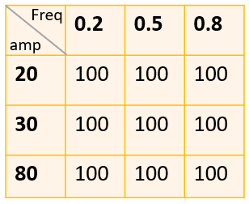
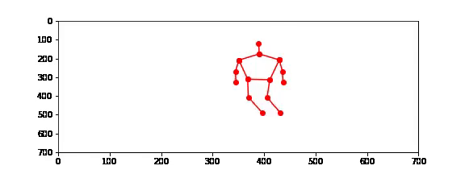
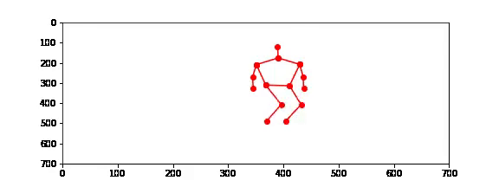
XAI: Effectiveness by perturbation
Perturbing one specific joint does not change the performance of
the model to distinguish two class of “walking” & “jumping jacks”

Slide 8
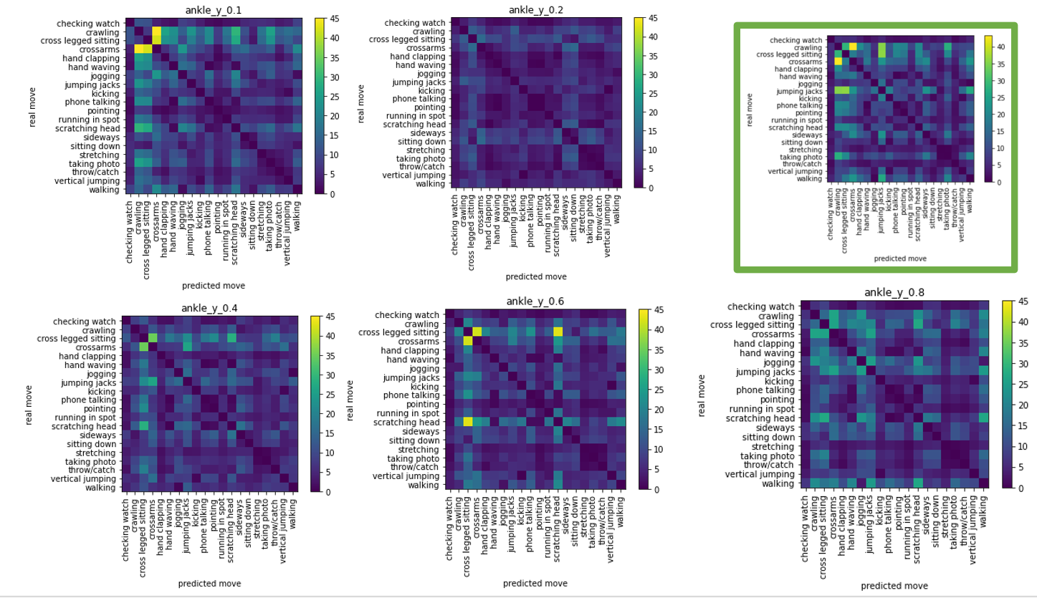
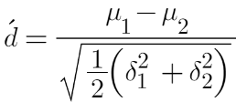
XAI: Effectiveness by perturbation
Calculating d-prime between each two categories.

Slide 9
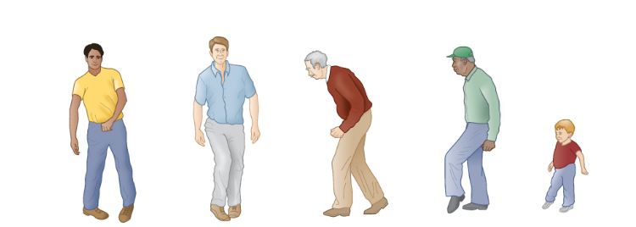
Purposes to be covered:
Gain insight regarding what aspects of movements are characteristic of movement disorders
Neurological disorders assessment and diagnosis: Can we provide a pattern or score for each movement, so it will distinguish normal and abnormal movements
Explanatory artificial intelligence (XAI): we can achieve specific tools that can help to interpret machine learning pipelines.

Slide 10
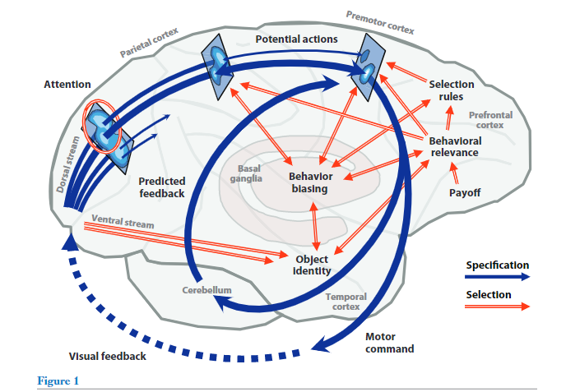
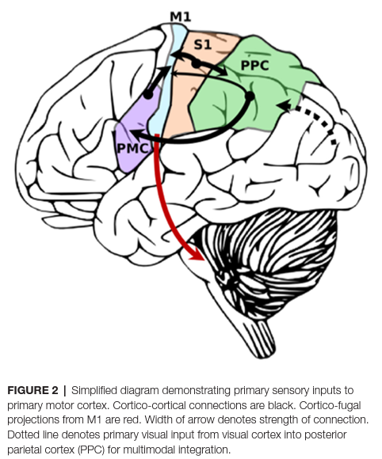
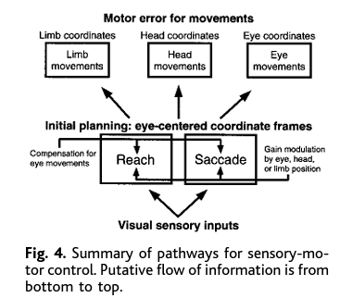
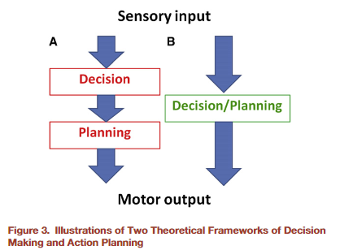
Project 2: Background
Cisek, P., & Kalaska, J. F. (2010).
Edwards LL, et al. (2019)
Batista, A. P., Buneo, C. A., Snyder, L. H., & Andersen, R. A. (1999).
Andersen, R. A., & Cui, H. (2009).

Slide 11
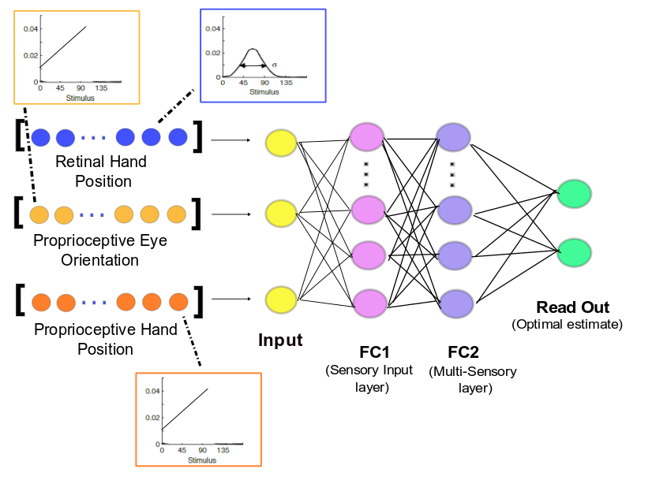
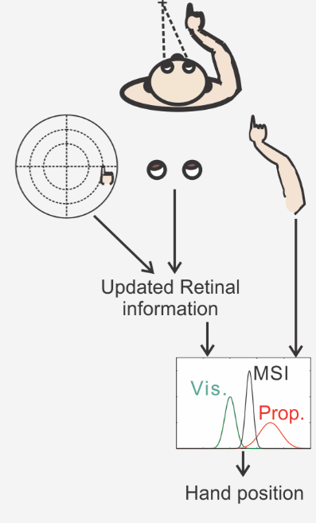
Project 2: Multisensory Integration
Question: Can ANN perform Multisensory Integration?
µ
δ

Slide 12
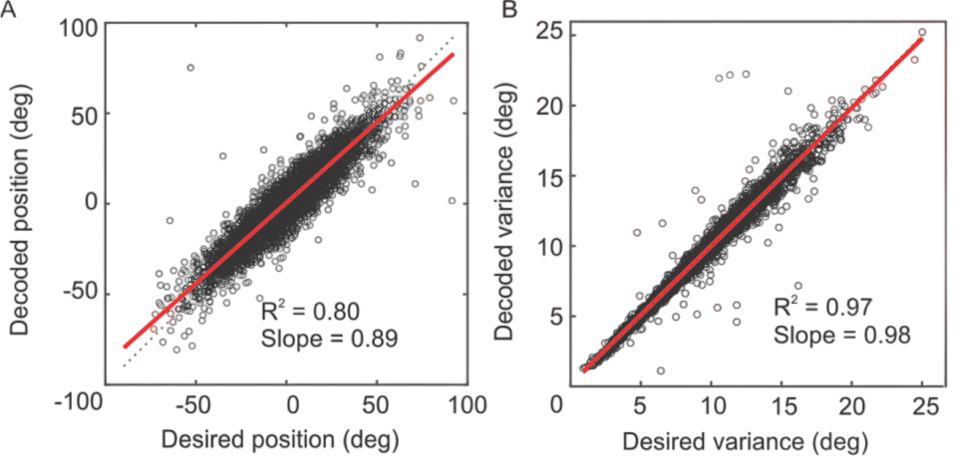
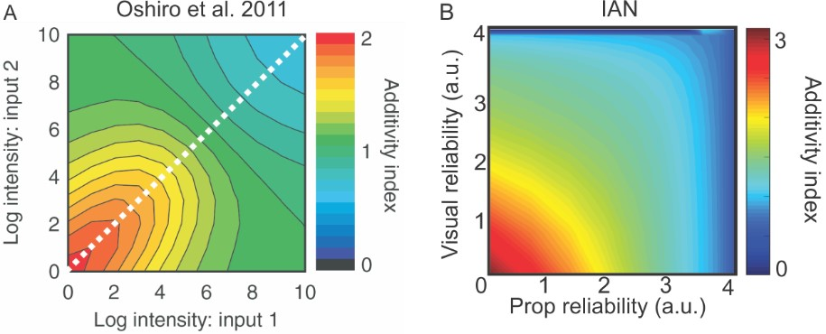
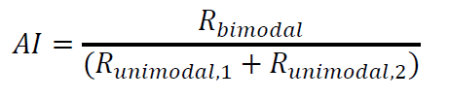
Results
Performs well with a fraction of the neurons required by explicit normalization method.
Does not require a neat preconfigured connectivity structure between neurons or explicitly matching population codes for individual neurons.
Produces a wide range of behaviors similar to recorded activity in the brain.

Slide 13
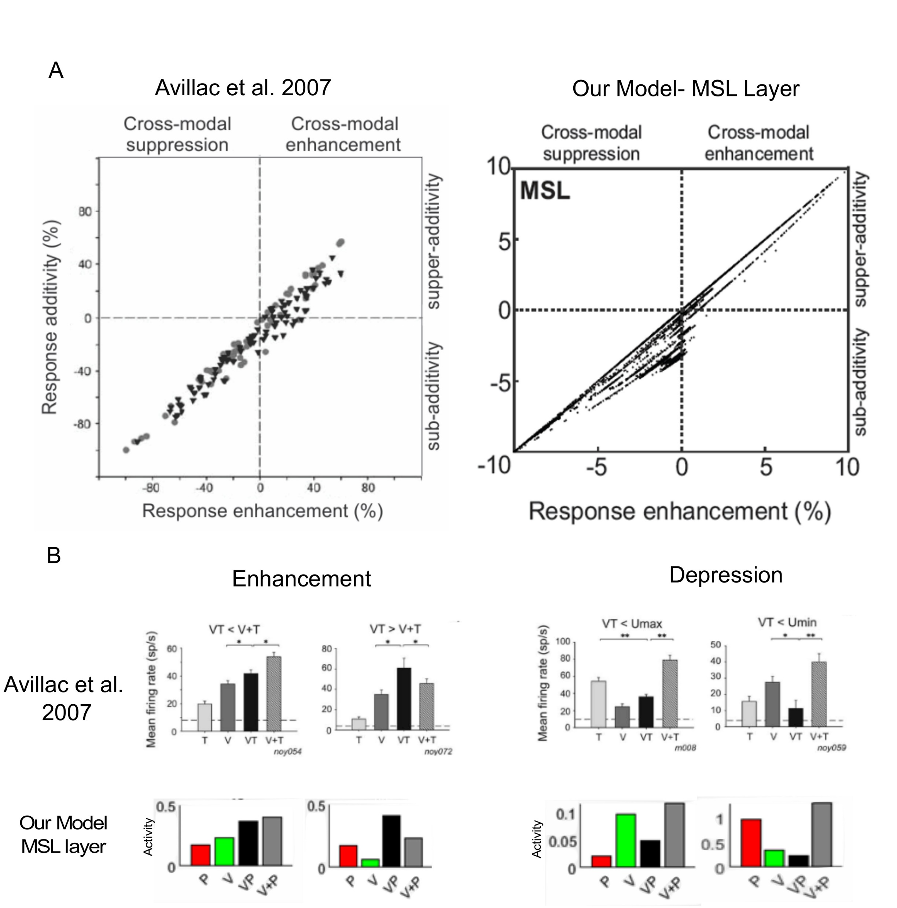
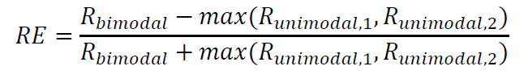
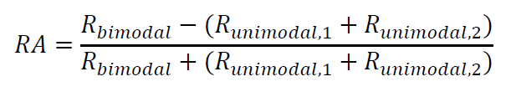
Results
Inverse Effectiveness
Multi-sensory suppression
Super-additivity

Slide 14
Purposes to be covered:
Explicit divisive normalization is not necessary for multisensory integration.
Adding causality
Doing micro-stimulation and compare the behavior with the neural data
Implementing this model in real-world application (Robotics)

Slide 15
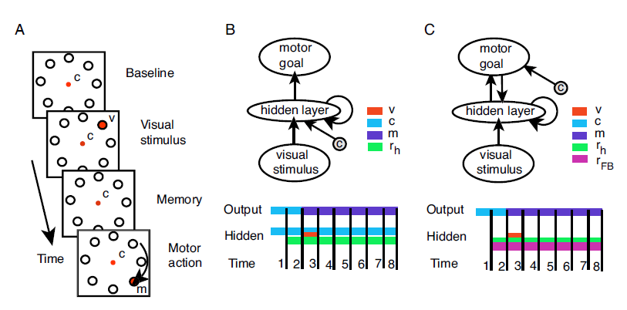
Project 3: Ideas
Visuomotor Transformation, the integration of sensory signals with abstract behavioral rules(contexts) and how this results in decisions about motor actions.
Sensory-motor encoding disassociation, how the brain encodes and processes sensory-motor information for different motor tasks.
Can we design a model that is able to handle two different motor task using a context/rule signal?
Does it need different form of transformation hile receiving same while receiving sensory information?
Brozovic´ et al. Contextually Guided Visuomotor Transformations

Slide 16
Project Timelines
Research Plan |  | 2022 |  |  |  |  |  |  |  |  |  |  |  | 2023 |  |  |  |  |  |  |  |  |  |  |  | 2024 |  |  |  |  |  |  |  |  |  |  |  | 2025
subject | Month | J | F | M | A | M | J | J | A | S | O | N | D | J | F | M | A | M | J | J | A | S | O | N | D | J | F | M | A | M | J | J | A | S | O | N | D | J | F | M | A | M | J | J | A | S | O | N | D
Subject 1: Movement Classification
Model design – Data processing
RDM- Tsne & perturbation analysis
Reconstruction model- Score definition
Finalize project- Manuscript, figures,…
Subject 2: Multisensory Integration
Literature review
Model review and implementations
Finalize figures - abstract submission
Writing manuscript - edits
Subject 3: ?
Improve MSI model for reach plan
Anti / pro saccade and reach movements
Neural population dynamic analysis for both saccade and reach
Committee Meetings
Comprehensive Exam
Thesis Defense

